Slide 1
Text Pre-processing

Slide 2
Supercar Racing Data
id | text | event_number | player_dummy | team_dummy | weekday | month | day | time | user_screen_name
2 | "congrats to all this weeks winners. you'll all be listed in this saturday's @thetiser and in tomorrow's fringe enews. #adlfringe #adelaide" | 1 | 0 | 0 | 5 | 2 | 28 | 14:02 | adlfringe
242 | "crappy weather means it's a perfect day to stay in and watch #v8sc hoping to see both @redbullracingau cars lead the way" | 1 | 0 | 0 | 6 | 3 | 1 | 20:26 | _maniacalmitch
252 | "the sun is up and we're ready for day 3 of #clipsal500 are you? http://t.co/nnfqvngjvi" | 1 | 0 | 0 | 6 | 3 | 1 | 20:33 | adelaide500
304 | "race report: thrilling podium finish for #volvo #polestar racing in #v8sc-debut: http://t.co/4ys2yb4jsk http://t.co/kqwmouxexv" | 1 | 0 | 0 | 7 | 3 | 2 | 13:20 | polestarcars
322 | "just spotted @chaz_mostert in that picture as well class! #v8sc" | 1 | 0 | 0 | 7 | 3 | 2 | 13:38 | james_newbold
323 | "set the #v8sc to record on 7mate and halfway the telecast switches back to 7. meaning it didn't record. f you #channel7 #shambles #bring10" | 1 | 0 | 0 | 7 | 3 | 2 | 13:39 | haydenjohnson94
342 | "i may only have seen just the one race so far, but i already rank v8 supercars higher than dtm, wtcc and stcc. #v8sc" | 1 | 0 | 0 | 7 | 3 | 2 | 13:49 | __ashima

Slide 3
Tokenization/Segmentation
The process of breaking a stream of textual content into words, terms, symbols, or other meaningful elements.
Task: what is the most likely segmentation /tokenization?
There was an earthquake near Washington. I’ve even felt it in Philadelphia.
There + was + an + earthquake + near + Washington + .
I + ’ + ve + even + felt + it + in + Philadelphia+.

Slide 4
Tokenization
"heartbreaking moment for shane van gisbergen as his car fails to start from the pits! heartbreaking! shane! #v8sc"
Tokenize in Python
Remove punctuations
from nltk.tokenize import TweetTokenizer
Tokenizer = TweetTokenizer()
tokenized = Tokenizer.tokenize(tweet)
['"', 'heartbreaking', 'moment', 'for', 'shane', 'van', 'gisbergen', 'as', 'his', 'car', 'fails', 'to', 'start', 'from', 'the', 'pits', '!', 'heartbreaking', '!', 'shane', '!', '#v8sc', '"']
import string
punctuation = list(string.punctuation)
tokenized_no_punctuation=[word.lower() for word in tokenized if word not in punctuation]
['heartbreaking', 'moment', 'for', 'shane', 'van', 'gisbergen', 'as', 'his', 'car', 'fails', 'to', 'start', 'from', 'the', 'pits', 'heartbreaking', 'shane', '#v8sc'

Slide 5
Stop Words Removal
A group of words that carry no meaning by themselves
For example, in, and, the, a, an, which
A standard dictionary can be used
Or a custom stop-word dictionary can be used
from nltk.corpus import stopwords
tokenized_no_stopwords=[word for word in tokenized_no_punctuation if word not in stopwords.words('english’)]
'heartbreaking', 'moment', 'shane', 'van', 'gisbergen', 'car', 'fails', 'start', 'pits', 'heartbreaking', 'shane', '#v8sc']
from sklearn.feature_extraction import text
my_additional_stop_words = [“#v8sc”]
stop_words = text.ENGLISH_STOP_WORDS.union(my_additional_stop_words)

Slide 6
Stemming
A stem is the base part of the word, to which affixes can be attached for derivatives
Stemming keeps only the base word, thus reducing the total words in the corpus
Stemming simply cuts off the affix and may not be a complete word
For example, “combin” is the stem for combine , combining , combined
from nltk.stem.porter import PorterStemmer
tokens = [PorterStemmer().stem(word) for word in tokenized_no_stopwords]
['heartbreak', 'moment', 'shane', 'van', 'gisbergen', 'car', 'fail', 'start', 'pit', 'heartbreak', 'shane', '#v8sc']

Slide 7
Lemmatization
Similar to stemming, but produces a proper root word that belongs to the language
Uses a dictionary to match words to their root word
For example, “combine” is the lemmatized version of combine, combined, and combining
from nltk.stem import WordNetLemmatizer
tokens = [WordNetLemmatizer().lemmatize(word) for word in tokenized_no_stopwords]
['heartbreaking', 'moment', 'shane', 'van', 'gisbergen', 'car', 'fails', 'start', 'pit', 'heartbreaking', 'shane', '#v8sc']

Slide 8
Turning Tokens to Numerical Representations (Feature Extraction)
Bag of words
N-grams
TF-IDF (Term Frequency/Inverse Document Frequency)
Word embedding (Neural network)
Word2Vec(Google)
GloVe (Stanford)
FastText (Facebook)
BERT (Google)

Slide 9
Bag of Words
A text is represented as the bag of its words
from sklearn.feature_extraction.text import CountVectorizer
vectoriser = CountVectorizer()
BoW= vectoriser.fit_transform(tokens)
['car’:1, 'fails’:1, 'gisbergen’:1, 'heartbreaking’:1, 'moment’:1, 'pit’:1, 'shane’:1, 'start’:1, 'v8sc’:1, 'van’:1]

Slide 10
N-Grams
N-grams is a sequence of n items in a sample of text
Bigrams, trigrams, four-grams, and so on
For example, “Dogs are favourite pets”
Bigrams: (Dogs, are), (are, favourite), (favourite, pets)
Trigrams: (Dogs, are, favourite)(are, favourite, pets)
from sklearn.feature_extraction.text import CountVectorizer
vectoriser = CountVectorizer(ngram_range=(1, 2))
n_gram = vectoriser.fit_transform([tweet])
print(vectoriser.fit([tweet]).vocabulary_)
{'heartbreaking': 12, 'moment': 17, 'for': 6, 'shane': 21, 'van': 31, 'gisbergen': 10, 'as': 0, 'his': 15, 'car': 2, 'fails': 4, 'to': 28, 'start': 24, 'from': 8, 'the': 26, 'pits': 19, 'v8sc': 30, 'heartbreaking moment': 13, 'moment for': 18, 'for shane': 7, 'shane van': 23, 'van gisbergen': 32, 'gisbergen as': 11, 'as his': 1, 'his car': 16, 'car fails': 3, 'fails to': 5, 'to start': 29, 'start from': 25, 'from the': 9, 'the pits': 27, 'pits heartbreaking': 20, 'heartbreaking shane': 14, 'shane v8sc': 22}

Slide 11
TF-IDF (Term Frequency/Inverse Document Frequency)
A technique to quantify the importance of the word in the document and corpus.
Term Frequency: normalized frequency value in a document (the frequency divided by the total number of words in the document).
Inverse Document Frequency: the inverse of the document frequency which measures the informativeness of the term.
from sklearn.feature_extraction.text import TfidfVectorizer
vectoriser = TfidfVectorizer()
Tfidf = vectoriser.fit_transform([tweet])
print(vectoriser.get_feature_names())
['as', 'car', 'fails', 'for', 'from', 'gisbergen', 'heartbreaking', 'his', 'moment', 'pits', 'shane', 'start', 'the', 'to', 'v8sc', 'van']

Slide 12
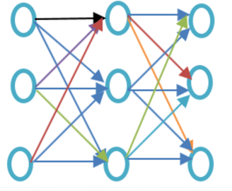
Word2Vec(Google)
A technique to produce word embedding for better word representation. It captures a large number of precise syntactic and semantic word relationship. It is a shallow two-layered neural network.
The shallow neural network consists of the only a hidden layer between input and output whereas deep neural network contains multiple hidden layers between input and output.

Slide 13
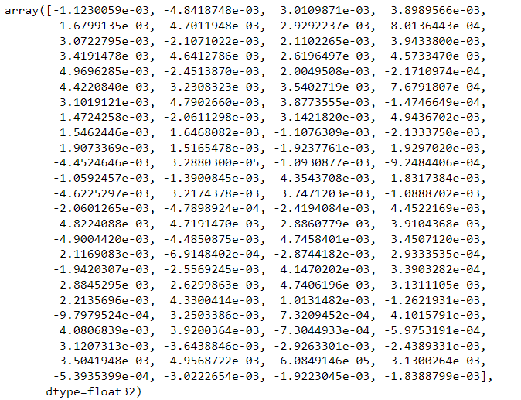
Word2Vec(Google)
from gensim.models import Word2Vec
model = Word2Vec([tokens], size=100, window=5, min_count=1, workers=4)
print(model.wv["heartbreaking"])
print(model.wv.most_similar("heartbreaking"))
[('#v8sc', 0.1389063000679016), ('pit', 0.10494619607925415), ('moment', 0.08247969299554825), ('fails', 0.02073480561375618), ('van', -0.0442444272339344), ('start', -0.06102637201547623), ('shane', -0.0871562734246254), ('gisbergen', -0.11229747533798218), ('car', -0.22383444011211395)]

Slide 14
Part-of-Speech Tagging
POS tagging involves identifying the part of speech for each word in a corpus
Usually, parts of speech: Verbs, Nouns, Pronouns (e.g., he, their, her, its, my, I, us) Adjectives, Adverbs, prepositions (e.g., on, of, at with, by, into, under), Conjunctions (e.g., and, or, but , if, while, although), Determiners (e.g., the, a, some most, every), Interjections (e.g., ouch!, wow!)
Used for entity recognition, and sentiment analysis
A + dog + is + chasing + a + boy + on + the + playground
Det
Noun
Verb
Verb
Det
Noun
Prep
Det
Noun

Slide 15
Part-of-Speech Tagging
import nltk
pos_tag=nltk.pos_tag(tokens)
print(pos_tag)
[('heartbreaking', 'VBG'), ('moment', 'NN'), ('shane', 'NN'), ('van', 'NN'), ('gisbergen', 'NN'), ('car', 'NN'), ('fails', 'VBZ'), ('start', 'VBP'), ('pit', 'NN'), ('heartbreaking', 'VBG'), ('shane', 'NN'), ('#v8sc', 'NN')]
VBG: verb gerund; NN: noun, singular; VBZ: verb, present tense with 3rd person singular; VBP: verb, present tense not 3rd person singular

Slide 16
Sentence-Based Text Analysis for Customer Reviews
Büschken and Allenby 2016, Marketing Science
https://pubsonline.informs.org/doi/10.1287/mksc.2016.0993
Makes use of the sentence structure contained in the reviews
Use data from
www.expedia.com
www.we8there.com
Show that it leads to improved inference and prediction of consumer ratings relative to existing models

Slide 17
Improving Text Analysis Using Sentence Conjunctions and Punctuation
Joachim Büschken , Greg M. Allenby 2020, Marketing Science
https://pubsonline.informs.org/doi/10.1287/mksc.2019.1214
Propose a new topic model that allows for serial dependency of topics in text
Topic carryover is informed by sentence conjunctions and punctuation. Typically, such observed information is eliminated prior to analyzing text data (i.e., preprocessing) because words such as “and” and “but” do not differentiate topics.
Find that these elements of grammar contain information relevant to topic changes.

Slide 18
Commonly-used NLP techniques

Slide 19
Commonly-used NLP techniques
Named Entity Recognition
Sentiment Analysis
Text Summarization
Topic Modeling
Word Cloud
Predictive Text

Slide 20
Named Entity Recognition
Determine text mapping to proper names
Task: what is the most likely mapping
Its initial Board of Visitors included U.S. Presidents Thomas Jefferson, James Madison, and James Monroe.
Its initial Board of Visitors included U.S. Presidents Thomas Jefferson, James Madison, and James Monroe.
Organization, Location, Person

Slide 21
Named Entity Recognition
from nltk import ne_chunk
ne_tree = ne_chunk(pos_tag)
print(ne_tree)
(S
heartbreaking/VBG
moment/NN
shane/NN
van/NN
gisbergen/NN
car/NN
fails/VBZ
start/VBP
pit/NN
heartbreaking/VBG
shane/NN
#v8sc/NN)

Slide 22
Text Summarization
As the name suggests, there are techniques in NLP that help summarize large chunks of text. Text summarization is mainly used in cases such as news articles and research articles.
#sentence tokenize
from nltk.tokenize import sent_tokenize
sentence_tokens = sent_tokenize(article_content)
print(sentence_tokens)
#Scoring a sentence by its words
sentence_weight = dict()
for sentence in sentence_tokens:
sentence_wordcount = (len(word_tokenize(sentence)))
sentence_wordcount_without_stop_words = 0
for word_weight in word_frequencies:
if word_weight in sentence.lower():
sentence_wordcount_without_stop_words +=1
if sentence in sentence_weight:
sentence_weight[sentence] += word_frequencies[word_weight]
else:
sentence_weight[sentence] = word_frequencies[word_weight]
sentence_weight[sentence] = sentence_weight[sentence]
print(sentence_weight)
from heapq import nlargest
select_length = int(len(sentence_weight)*0.01)
print(select_length)
summary = nlargest(select_length, sentence_weight, key = sentence_weight.get)
print(summary)
[100]\nClassification of machine learning models can be validated by accuracy estimation techniques like the holdout method, which splits the data in a training and test set (conventionally 2/3 training set and 1/3 test set designation) and evaluates the performance of the training model on the test set.': 3.697530864197532,

Slide 23

Word Cloud
A graphical display of words in a corpus
Size of word based on number of occurrences
Visual view of the most popular terms
Popular presentation concept in text analytics
from wordcloud import WordCloud
fig, ax = plt.subplots()
wordcloud = WordCloud(background_color="white", colormap='tab10', max_words=200).generate(str(tweets))
plt.imshow(wordcloud, interpolation='bilinear')
plt.axis('off')
plt.show()

Slide 24
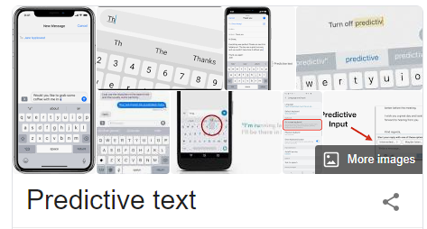
Predictive Text
Recommend next word
Choose from list instead of typing
How it works
Corpus of sentences
N-grams used to build a database
Predict from the database

Slide 25
Sentiment Analysis
Topic Modeling
To identify natural topics in the text.
Supervised learning
Unsupervised learning
A prime advantage is that model training and a labeled training dataset are not required.
Identify, extract, quantify, and study affective states and subjective information
The simplest output of sentiment analysis is a 3-point scale: positive/negative/neutral.
In more complex cases the output can be a numeric score that can be bucketed into as many categories as required.
Sentiment analysis is widely applied to voice of the customer materials such as social media/online reviews and survey responses

Slide 26

Extra Resource
https://www.vitalsource.com/en-au/

